Slide 1
Cyclistic Bike sharing Analysis
File created on: 7/18/2022 4:14:01 PM

Slide 2
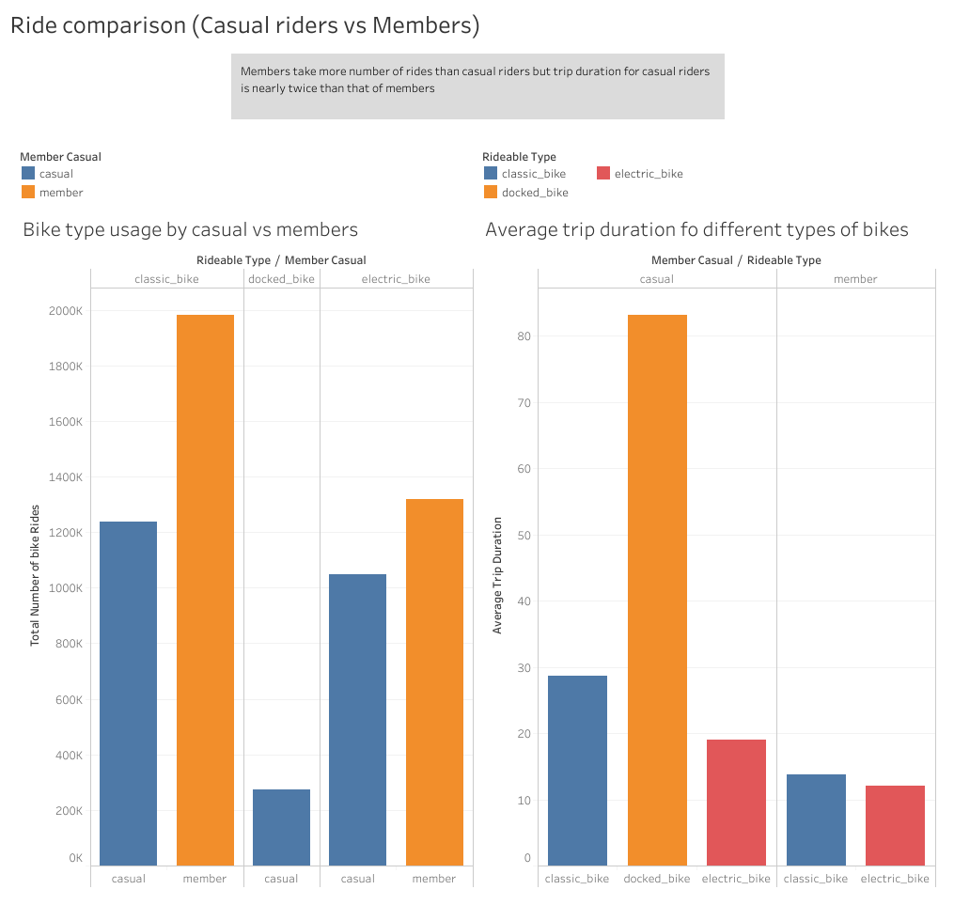

Slide 3
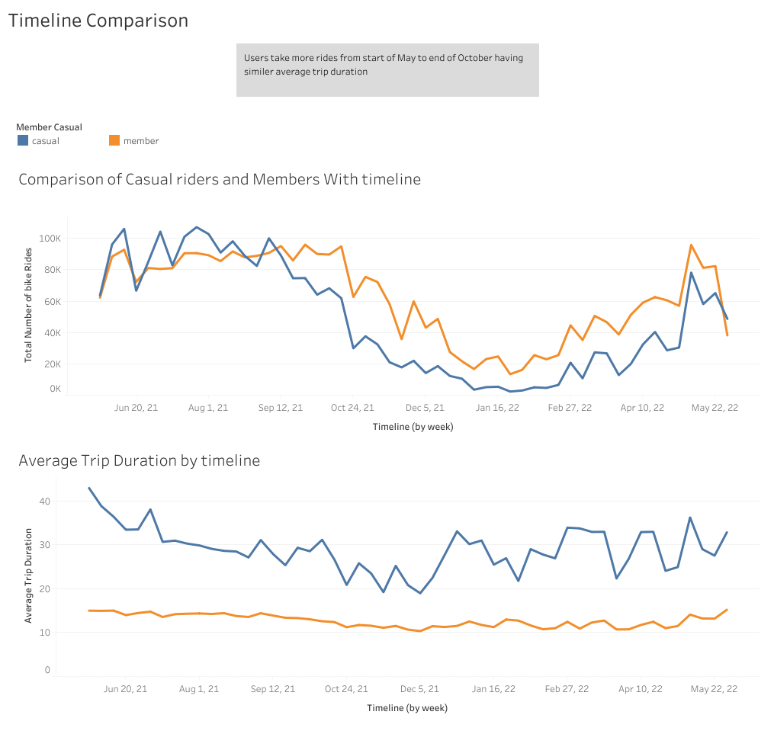

Slide 4
